Slide 1

Data Mining
BY
Adnan Amin
Lecturer, IMSciences, Peshawar
adnan.amin@imsciences.edu.pk

Slide 2
Outlines
Data Explosion
Classification
Labeled/Unlabeled
Supervised learning: Naïve Bayes

Slide 3
The Data Explosion
The current NASA Earth observation satellites generate a terabyte (i.e. 10^9 bytes) of data every day.
There are over 900 million users of Facebook (rapidly increasing), with an estimated 3 billion postings a day.
There are estimated to be over 650 million websites, some extremely large.
There are vast amounts of data recorded every day on automatic recording devices, such as credit card transaction ﬁles and web logs, as well as non-symbolic data such as CCTV recordings.

Slide 4
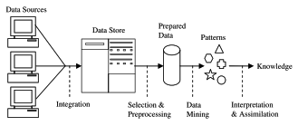
Knowledge Discovery
Non-trivial extraction of implicit, previously unknown and potentially useful information from data. OR
The science of extracting useful information from large data sets or databases.

Slide 5
Labeled and Unlabeled Data
Usually, we have two types of data (data set).
Labeled data
Unlabeled data
Labeled data:
It is a specially designated attribute and the aim is to use the data given to predict the value of that attribute.
Data mining using labelled data is known as supervised learning.
Unlabeled data:
Data that does not have any specially designated attribute is called unlabeled.
Data mining of unlabeled data is known as unsupervised learning.

Slide 6
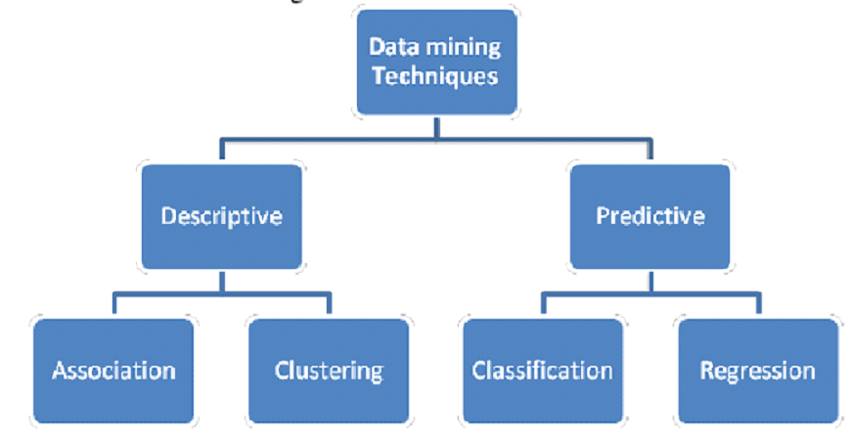

Slide 7
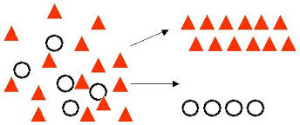
Supervised Learning: Classiﬁcation
3
4
Training Set
Classifier
Here, we can try
Various type of algorithms
e.g., Naïve Bayes
1
2
Learning Step
_{Dataset}
Split
Classification Step
5
6
Validation
8
Test Set
Predict the Class Label
7
© Adnan Amin | IMSciences Peshawar
Unseen Sample

Slide 8
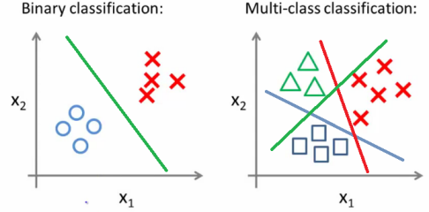
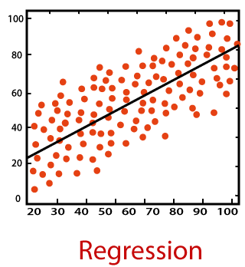
Supervised Learning: Classiﬁcation
Target / Special / Class Attribute may contains:
Binary-Class Classification
Multi-Class Classification
Numerical Classification (Regression)

Slide 9
Techniques to classify the data
There are several ways we can do for classifying the data, including the following.
Nearest Neighbour Matching.
Classification Rules.
Classification Tree.
Probabilistic Learning.

Slide 10
Nearest Neighbour Matching
This method relies on identifying the Kth (let k=3) instances that are ‘closest’ in some sense to an unclassiﬁed one.
If the 3 ‘nearest neighbours’ have class label Second, First, Second.
We might reasonably conclude that the new instance should be classiﬁed as ‘Second’. (Majority Voting)

Slide 11
Classification Rules
We look for rules that we can use to predict the classiﬁcation of an unseen instance, for example:
IF DM = A AND Java = A THEN Class = First
IF DM = A AND Java = B AND PHP = B THEN Class = Second
IF DM = B THEN Class = Second

Slide 12
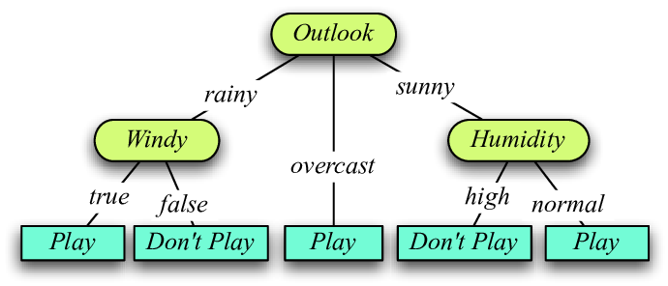
Classification Tree
One way of generating classiﬁcation rules is via an intermediate tree-like structure called a classiﬁcation tree or a decision tree.

Slide 13
Introduction to Classiﬁcation: Naïve Bayes Algorithm
Prerequisites
Probability: A sound understanding of conditional and marginal probabilities and Bayes Theorem is desirable.

Slide 14
Naïve Bayes
Probabilistic classification technique based on Bayes’ Theorem with an assumption of independence among predictors.
In simple terms, a Naive Bayes classifier assumes that the presence of a particular feature in a class is unrelated to the presence of any other feature.
Assumption
Naive Bayes assumption is that each feature makes an:
independent
equal
contribution to the outcome.

Slide 15
Naïve:
Features that go into the model is independent of each other.
That is changing the value of one feature, does not directly influence or change the value of any of the other features used in the algorithm.

Slide 16
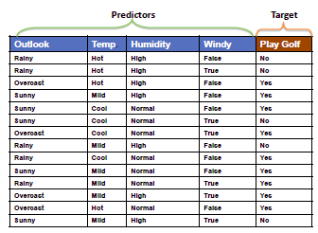
For Example:
We assume that no pair of features are dependent.
E.g., the temperature being ‘Hot’ has nothing to do with the humidity.
Each feature is given the equal weight(importance).
E.g., knowing only temperature and humidity alone can’t predict the outcome accurately.
Note: The assumptions made by Naive Bayes are not generally correct in real-world situations.

Slide 17

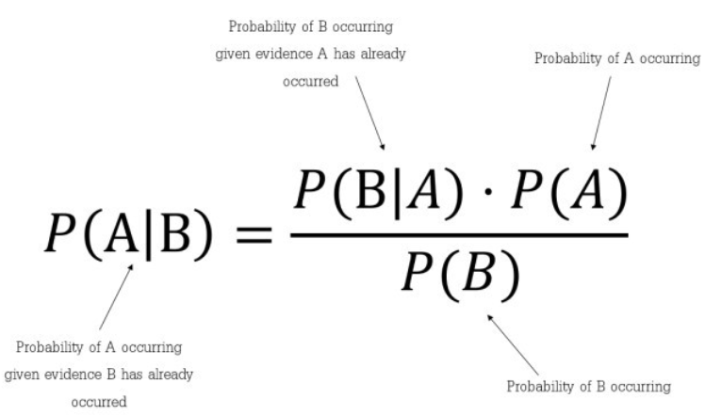

Conditional Probability
When you say the conditional probability of A given B, it denotes the probability of A occurring given that B has already occurred.
Mathematically, Conditional probability of A given B can be computed as:
For example:
When you flip a fair coin, there is an equal chance of getting either heads or tails. So you can say the probability of getting heads is 50%.
Similarly what would be the probability of getting a 1 when you roll a dice with 6 faces? Assuming the dice is fair, the probability of 1/6 = 0.166.

Slide 18
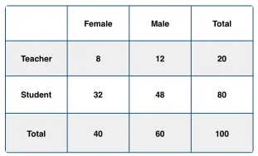

Conditional Probability
Q. What is the conditional probability that a certain member of the school is a ‘Teacher’ given that he is a ‘Man’?
A. To calculate this, you may intuitively filter the sub-population of 60 males and focus on the 12 (male) teachers.

Slide 19
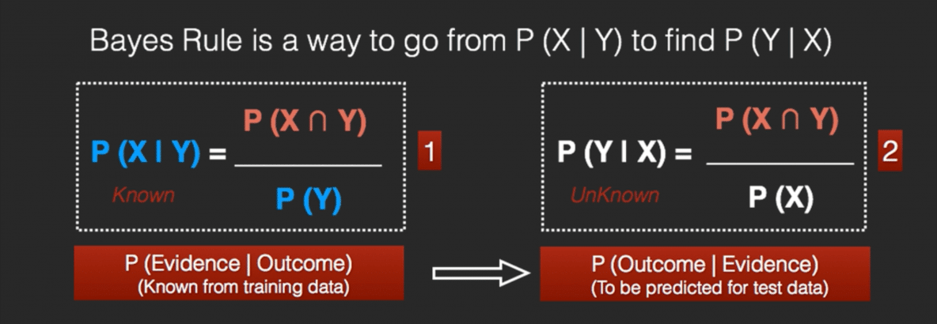
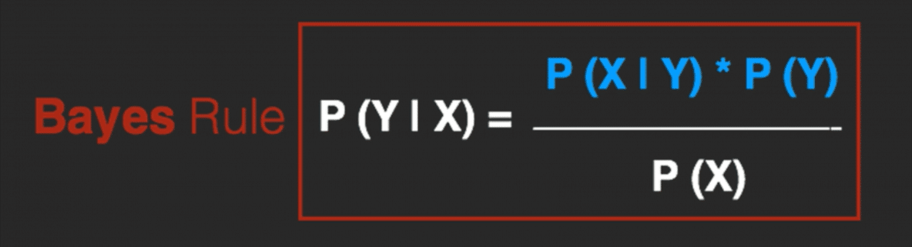
The Bayes Rule
X is a dependent feature vector
X = (Rainy, Hot, High, False)
y = No
So basically, P(y|X) here means, the probability of “Not playing golf” given that the weather conditions are “Rainy outlook”, “Temperature is hot”, “high humidity” and “no wind”.
Naïve Assumption
P(A,B) = P(A)P(B)

Slide 20
Frequencies Table
Class Probability/
Prior Probability
P(yes) = 9/14
P(no) = 5/14

Slide 21
Example
Suppose we have a Day with the following values :
Outlook = Rain
Humidity = High
Wind = Weak
Play = ?
So, with the data, we have to predict wheter "we can play on that day or not."

Slide 22
Solutions
Likelihood of 'Yes' on that Day = P(Outlook = Rain|Yes)*P(Humidity= High|Yes)* P(Wind= Weak|Yes)*P(Yes)
= 2/9 * 3/9 * 6/9 * 9/14 = 0.0199
Likelihood of 'No' on that Day = P(Outlook = Rain|No)*P(Humidity= High|No)* P(Wind= Weak|No)*P(No)
= 2/5 * 4/5 * 2/5 * 5/14 = 0.0166
Now, when we normalize the value, we get:
P(Yes) = 0.0199 / (0.0199+ 0.0166) = 0.55
P(No) = 0.0166 / (0.0199+ 0.0166) = 0.45
Our model predicts that there is a 55% chance there will be a game tomorrow.

Slide 23
The zero-frequency problem in NB
You have no occurrences of a class label and a certain attribute value together then the frequency-based probability estimate will be zero. And this will get a zero when all the probabilities are multiplied. OR
When you have a model with many features, the entire probability will become zero because one of the feature’s value was zero.
For Example: X = <rain, hot, high, overcast>
Solution: Laplace Correction
To avoid this, we increase the count of the variable with zero to a small value (usually 1) in the numerator, so that the overall probability doesn’t become zero.
Note: Most Naive Bayes model implementations accept this or an equivalent form of correction as a parameter.

Slide 24
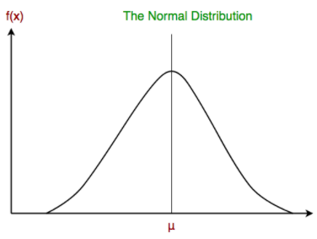
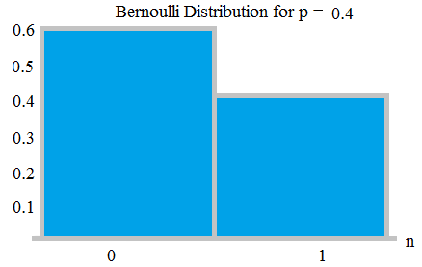


Naïve Bayes in Python
There are three types of Naive Bayes model under the scikit-learn library.
Gaussian NB: When continuous values associated with each feature are assumed to be distributed according to a Gaussian distribution. A Gaussian distribution is also called Normal distribution.
Multinomial NB: It is used for discrete counts. E.g., text classification problem, where count how often word occurs in the document.
Fraction of times word Wi appears among all words in the documents of topics Cj
Bernoulli NB: There may be multiple features but each one is assumed to be a binary-valued (Bernoulli, boolean) variable. (binarize the feature’s values)
The likelihood of the features is assumed to be Gaussian, hence, conditional probability

Slide 25



Application of Naïve Bayes in Industry Research
Weather Forecasting
Medical Diagnoses
Span Filter

Slide 26
Python Implementation
import numpy as np
from sklearn.naive_bayes import GaussianNB
X = np.array([[-1, -1], [-2, -4], [-4, -6], [1, 2]])
Y = np.array([1, 1, 2, 1])
GNBclf = GaussianNB()
GNBclf.fit(X, Y)
Method to construct Gaussian Naïve Bayes Classifier.
This method will Fit Gaussian Naive Bayes classifier according to X and y.
print((GNBclf.predict([[1, 2]])))
This method will perform classification on an array of test vectors X.
Output:
[1]

